Slide 1
CSS-Bootstrap
Static Restaurant(3)

Slide 2
Webpage's Component
index.html: main html file
style.css: css file
bootstrap

Slide 3
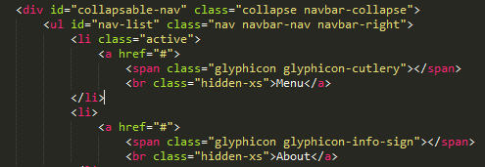
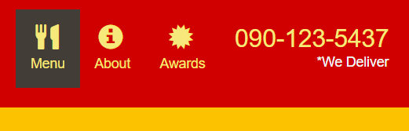
Single-category.html
The menu is in an activated state when browsing single-category site

Slide 4

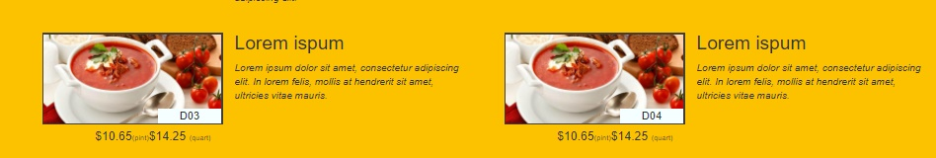
Single-category.html(2)
Description took 7/12 of the parent container (menu-item-tile)
The image took 5/12 of the parent container ((menu-item-tile)
Each itme took up 6/12 column of the grid system, which is half of the browser's width

Slide 5
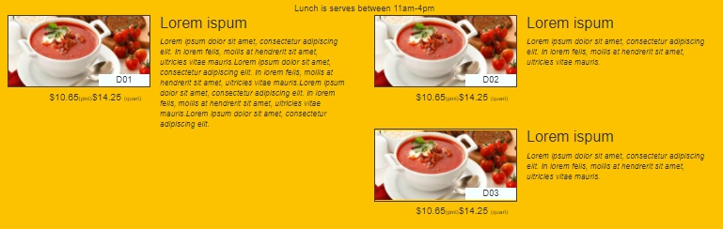
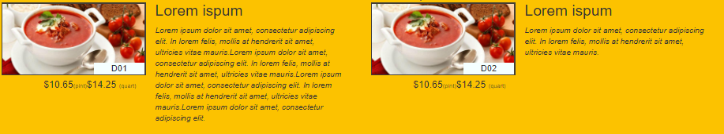
Single-category.html(3)
Prevent the overflow content from messing up the presentation

Slide 6
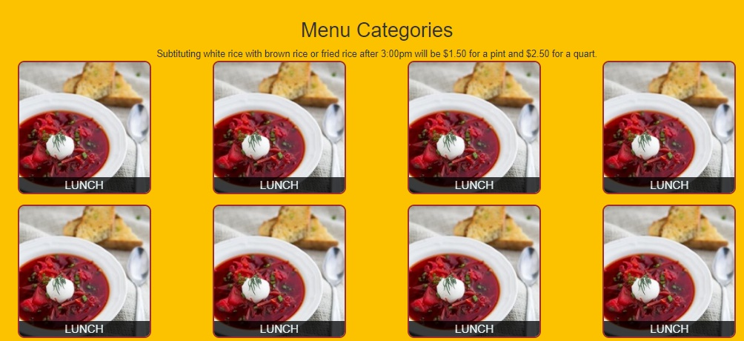
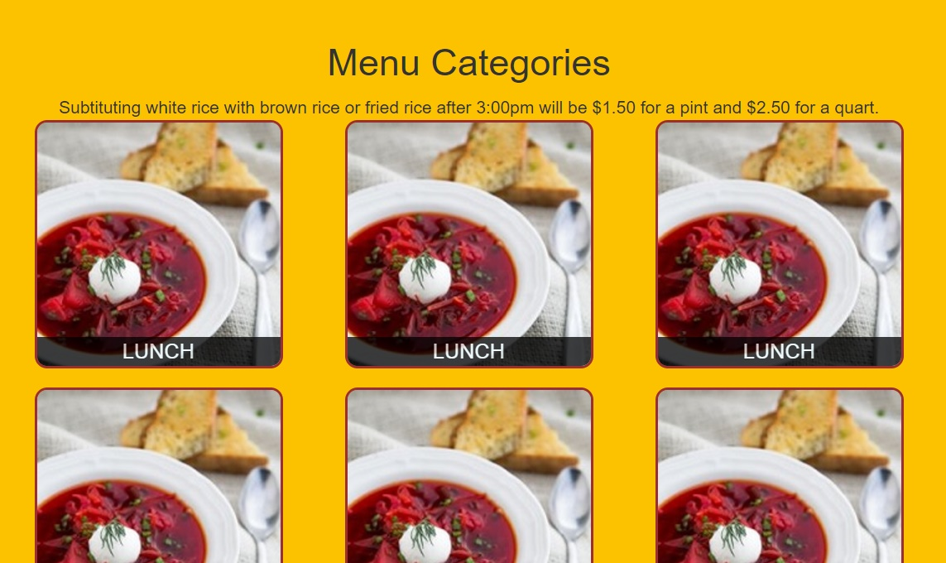
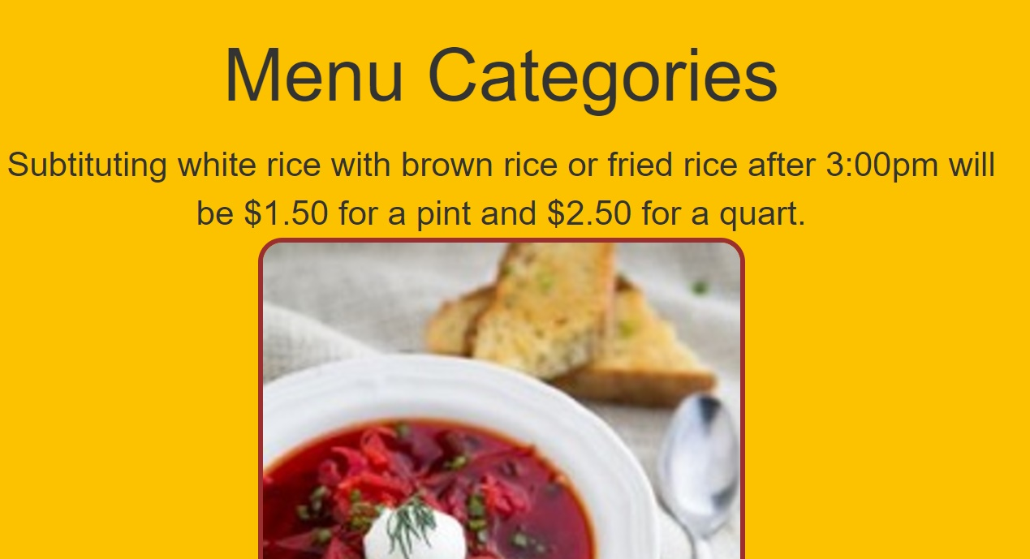
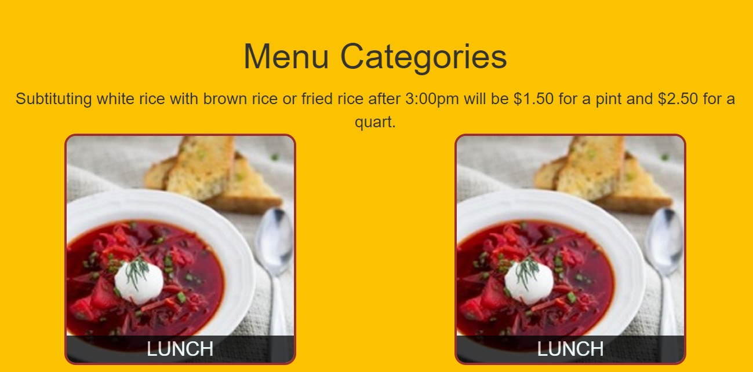
Menu-categories.html: Different sizes
Medium- 3 columns
Large- 4 columns
Extra small- 1 column
Small- 2 columns

Slide 7
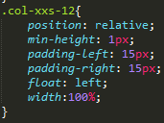
Menu-categories.html(2)
Newly defined xxs (extra-extra-small) columns system for 1 column display
4 columns
3 columns
2 columns
1 columns

